Slide 1
Vectors and Vector Addition
Scalar: magnitude, unit
Mass ex. 5 kg
Pressure ex. 32 psi
Speed ex. 8 m/s
Energy ex. 7.3 J
Vector: Magnitude, unit, direction
Velocity ex. 20 m/s East
Acceleration ex. 9.81 m/s² down
Force ex. 5.4 N @ 230º

Slide 2
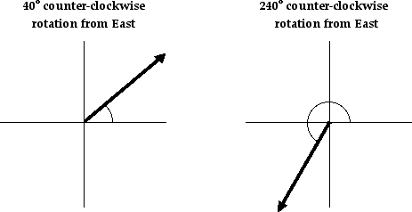
Vectors can be placed on a compass rose. We will use east = 0º
90º, north
180º, west
0º, 360º, east
270º, south
This could also be named 60º south of west

Slide 3
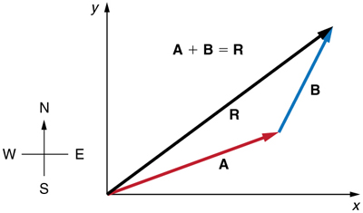
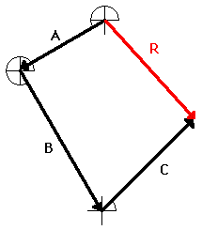
Vectors are added Head to tail. The sum of 2 or more vectors is called the resultant. A resultant should have a magnitude, unit and direction.
A + B + C = R
The magnitude of the resultant is the distance from where the vectors start to where the vectors end.

Slide 4
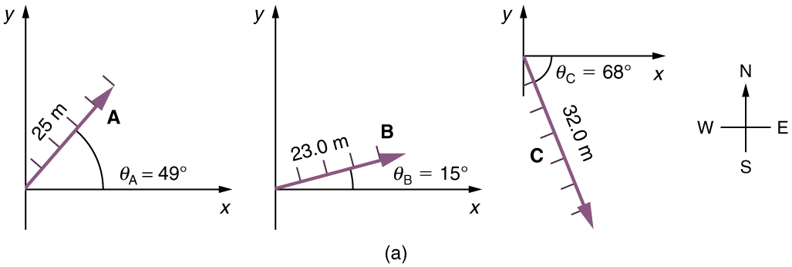
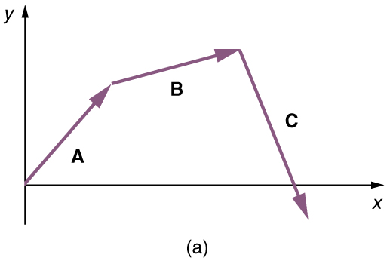
The resultant of several vectors can be found by a scale drawing using a ruler and protractor.
Suppose a girls goes for a walk. First, she walks 25.0 m in a direction 49.0º north of east. Then, she walks 23.0 m heading 15.0º north of east. Finally, she turns and walks 32.0 m in a direction 68.0° south of east.
Choose a scale, such as 1 cm=5m. Using a protractor, daw each vector to scale at the correct angle. Add the vectors head to tail.

Slide 5
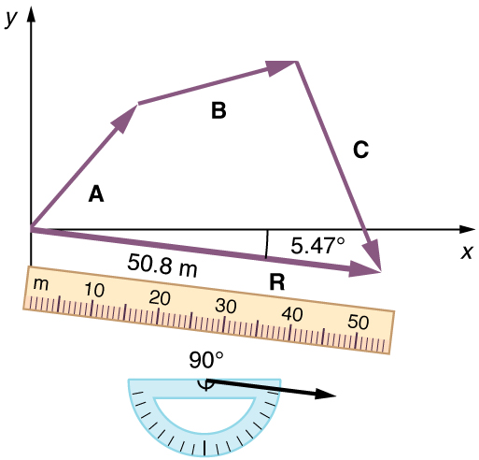
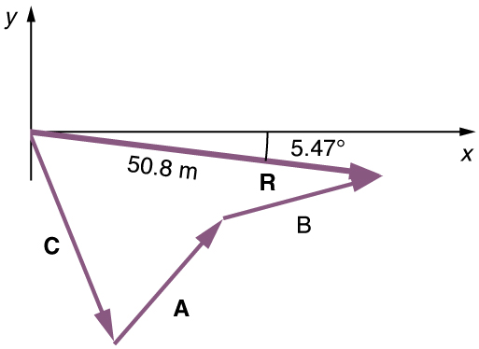
Then connect the start of the vectors directly to the end. This length is the magnitude of the resultant. Measure the length of the resultant and using your scale convert the length to meters. Measure the angle of the resultant. In this case it is 5.5º south of east, or 354.5º.
Note: The order of vector addition doesn’t matter with regards to the resultant. A + B + C = C + A + B = R
The resultant for both vector additions are the same.

Slide 6
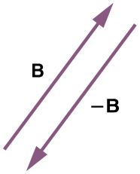
Figure 3.19
The negative of a vector is just another vector of the same magnitude but pointing in the opposite direction. So -B is the opposite of B ; it has the same length but points in the opposite direction.

Slide 7
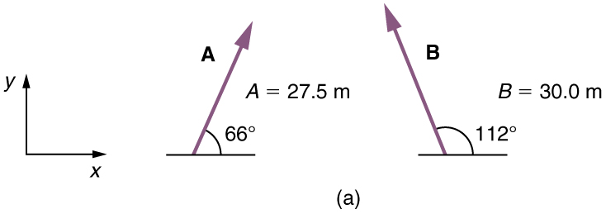
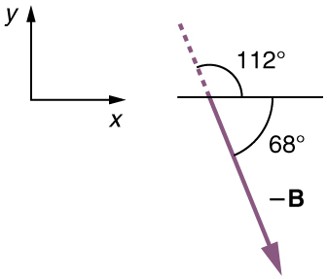
Vector A = 27.5 m @66º
Vector B = 30 m @ 112º
-B would have the same magnitude, 30 m, but point in the opposite direction. Since the angle of a straight line is 180º, the direction of -B would be 112º + 180º = 292º This could also be written as 68º south of east.

Slide 8
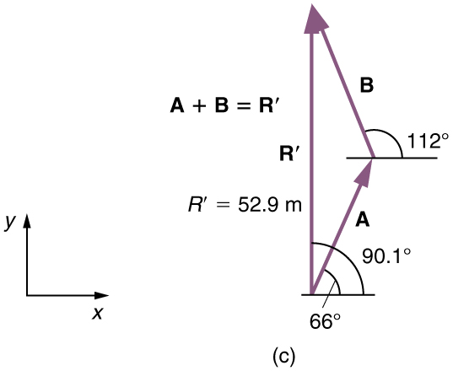
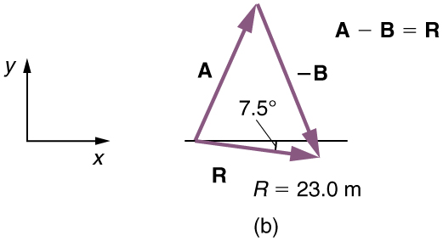
With vectors, A + B
≠ A - B

Slide 9
Finding the resultant of vectors that are in the x and y direction.
Draw the vectors head to tail on a compass rose.
Attempt to draw the lengths to scale (make the larger vector longer than the smaller vector)
Draw the resultant vector from the starting place to the ending place.
Find the magnitude of the resultant vector using the Pythagorean Theorem
Find the direction of the resultant vector using Trigonometric relations
Write the direction as an angle related to East or West…
and also as a number counterclockwise from 0º = East. A resultant pointing in the: 1st quadrant should be between 0º and 90º, 2nd quadrant between 90º and 180º, 3rd quadrant between 180º and 270º, and 4th quadrant between 270º and 360º.

Slide 10
Example 1
A car drives 40 km west then turns and drives 30 km south. Find magnitude and the direction of the resultant. Express the direction of the resultant 2 different ways.
50 km @ 217º or 37º south of west

Slide 11
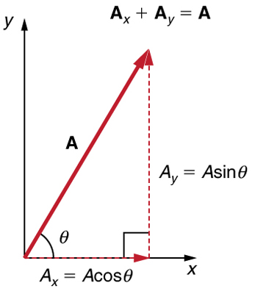
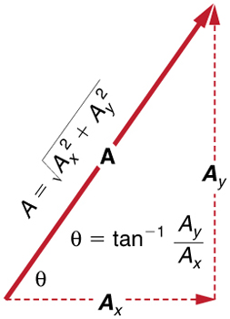
Adding Vectors where one or more vectors are not in the x or y direction
Resolve each vector into its x (horizontal) and y (vertical) components. Find the x and y components using the Sine and Cosine relationships in a right triangle.
Add all the x components and the y components to obtain the x and y components of the resultant.
Use the x and y components of the resultant to find the Magnitude and the direction of the resultant vector. Find the magnitude of the hypotenuse using the Pythagorean theorem and the angle of the hypotenuse using the Tangent relationship in a right triangle

Slide 12
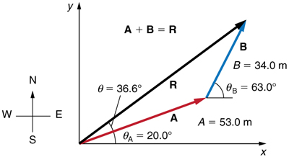
Example 2
A person walks 53.0 m @ 20º then 34.0 m @ 63º . Find the magnitude and direction of the resultant.

Slide 13
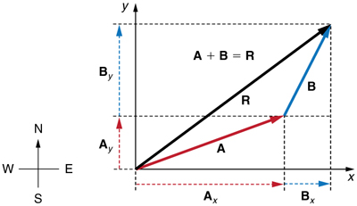
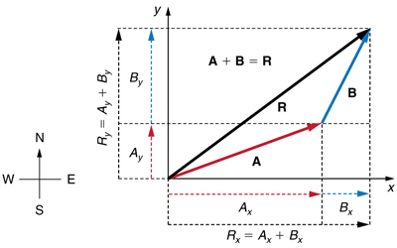
Find the x and y components of each vector. Adding the components of the vectors will give the components of the resultant.
 | X component | Y component
Vector A 53 m @ 20º | A_{x} = 53 cos 20º = 49.8 m | A_{y} = 53 sin 20º = 18.1 m
Vector B 34 m @ 63º | B_{x} = 34 cos 63º = 15.4 m | B_{y} = 34 sin 63º = 30.3 m
Resultant | R_{x} = 65.2 m | R_{y} = 48.4 m

Slide 14
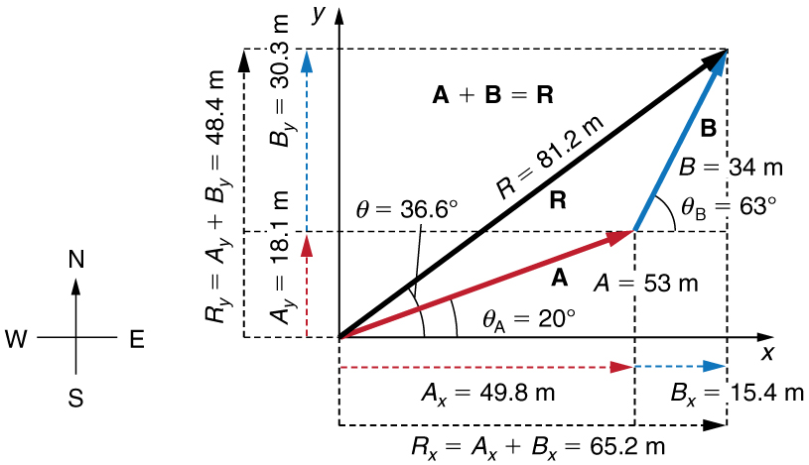
 | X component | Y component
Vector A 53 m @ 20º | A_{x} = 53 cos 20º = 49.8 m | A_{y} = 53 sin 20º = 18.1 m
Vector B 34 m @ 63º | B_{x} = 34 cos 63º = 15.4 m | B_{y} = 34 sin 63º = 30.3 m
Resultant | R_{x} = 65.2 m | R_{y} = 48.4 m

Slide 15
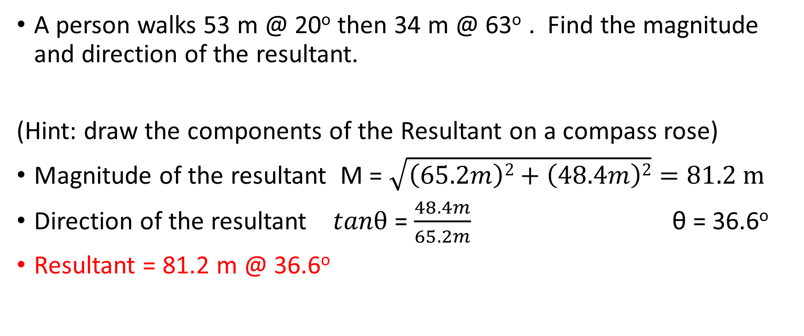
Example 2 (cont.)
A person walks 53 m @ 20º then 34 m @ 63º . Find the magnitude and direction of the resultant.
(Hint: draw the components of the Resultant on a compass rose)
Magnitude of the resultant M = $\sqrt{\left(65.2m\right)2+\left(48.4m\right)2}=81.2 m$
Direction of the resultant $tanθ$ = $\frac{48.4m}{65.2m}$ θ = 36.6º
Resultant = 81.2 m @ 36.6º

Slide 16
Note: Be careful when drawing the components of vectors. If you draw a vector in the negative direction and ALSO label it as negative, that actually changes the direction.
5.2 m
- 5.2 m
=
If a component of the resultant is negative it means it points in a negative direction.
Rx = - 5.2 m means it is 5.2 meters pointing in the negative direction or 5.2 m west or 180º
5.2 m
Rx = - 5.2 m
=

Slide 17
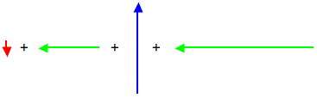
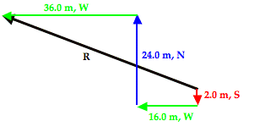
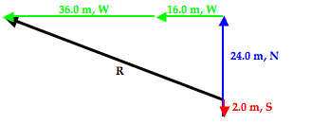
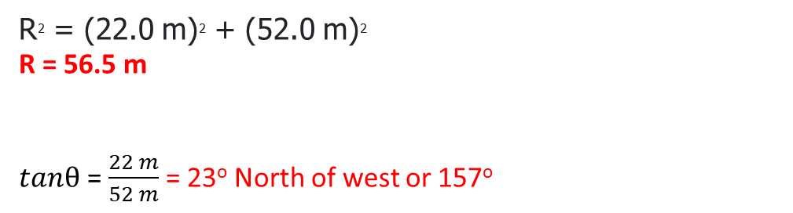
Example 3: Mac and Tosh are doing the Vector Walk Lab. Starting at the door of their physics classroom, they walk 2.00 meters, south. They make a right hand turn and walk 16.0 meters, west. They turn right again and walk 24.0 meters, north. They then turn left and walk 36.0 meters, west. What is the magnitude and direction of their overall displacement?
R² = (22.0 m)² + (52.0 m)² R = 56.5 m
$tanθ$ = $\frac{22 m}{52 m}$ = 23º North of west or 157º

Slide 18
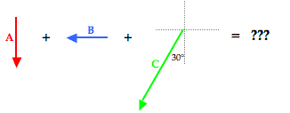
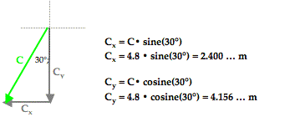
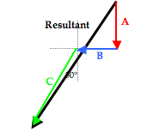
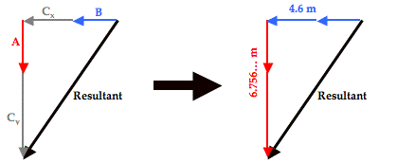

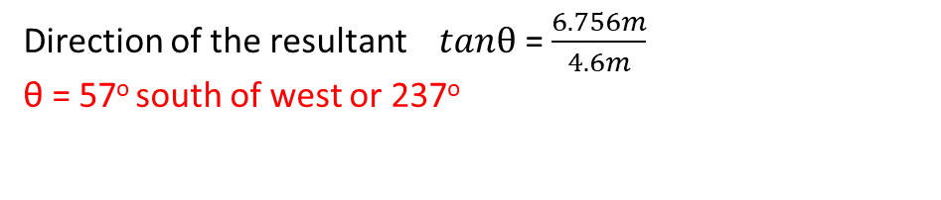
Example 3: Max plays middle linebacker for South's football team. During one play in last Friday night's game against New Greer Academy, he made the following movements after the ball was snapped on third down. First, he back-pedaled in the southern direction for 2.6 meters. He then shuffled to his left (west) for a distance of 2.2 meters. Finally, he made a half-turn and ran downfield a distance of 4.8 meters in a direction of 240° counter-clockwise from east (30° W of S) before finally knocking the wind out of New Greer's wide receiver. Determine the magnitude and direction of Max's overall displacement.
R² = (6.756… m)² + (4.6 m)²
R = 8.2 m
Direction of the resultant $tanθ$ = $\frac{6.756m}{4.6m}$
θ = 57º south of west or 237º

Slide 19
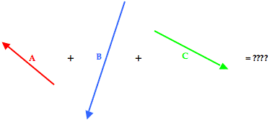
Example 4: Cameron Per (his friends call him Cam) and Baxter Nature are on a hike. Starting from home base, they make the following movements. A: 2.65 km, 140° B: 4.77 km, 252° C: 3.18 km, 332° Determine the magnitude and direction of their overall displacement.
R² = (0.696 km)² + (4.326 km)²
R = 4.38 km
80.9° south of west or 260.9°.

Slide 20
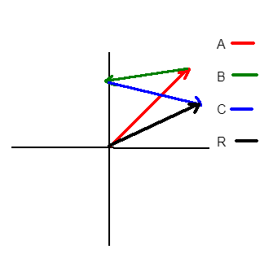
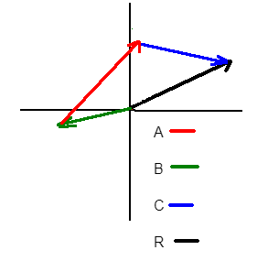
Vector A = 10.0 N @ 65º, Vector B = 6.0 N at 20º south of west, Vector C = 8.0 N @ 20º south of East
Make a sketch of A + B + C
Find the resultant of A + B + C
Make a sketch of B + A + C
Find the resultant of B + A + C
a)
b) 7.4 N @ 33º
c)
d) 7.4 N @ 33º

Slide 21
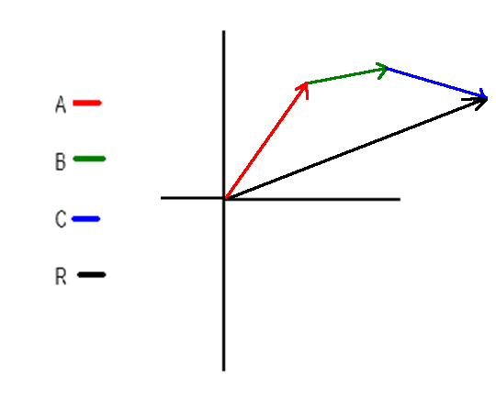
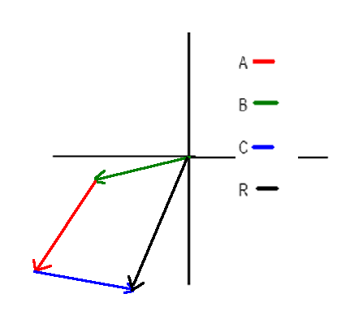
Vector A = 10.0 N @ 65º, Vector B = 6.0 N at 20º south of west, Vector C = 8.0 N @ 20º south of East
Make a sketch of A - B + C
Find the resultant of A - B + C
Make a sketch of B - A + C
Find the resultant of B - A + C
a)
b) 19 N @ 26º
c)
d) 14 N @ 261º
or 81º south of west

